Slide 1


公共衛生碩士學位學程
113學年度 實務實習說明會
113學年度
2025.03.04

Slide 2
修業規劃-健康政策與管理
基本核心課程(17)、領域必修課程(6)、選修課程(7)
一上：流行病學與生物統計學、健康政策管理與行為科學、
環境與職業衛生學、公共衛生：觀點與展望、
公共衛生研究法
一下：健康政策分析
二上：公共衛生實務專題討論、健康組織與管理、健康體系
寒假：公共衛生實務實習CEPH規範（200小時，可於原工作單位實習）
二下：海報展、碩士論文
Notes:
MPH希望領域能力至少能有一項

Slide 3
ITTO
專案管理-實習、論文
工具及技術
(Tool &
Technique)
輸入
(Input)
流程
(執行品質控制)
輸出
(Output)

Slide 4
實務實習流程圖
實務實習前
實務實習中
修畢核心必修（五門課）
撰寫實務實習月誌，並於每月10日前繳交前月之月誌。
一下3月3日（開學第二周）前，選定校內指導老師，並簽妥論文指導老師同意書，繳交學程辦公室。
經校內指導老師核可實務實習滿100小時後，應於一個月內繳交實務實習期中報告。
於二下開學後以加選形式選修課程MPH7013「公共衛生實務實習CEPH規範」，以利完成實務實習後取得學分。
同時也可選MPH7999 「碩士論文」，於該學期畢業。
由老師接洽或學生個人洽詢以確認實務實習單位，並選定實務實習單位指導老師。
與校內及實務實習單位指導老師共同討論：
  實務實習計劃書內容
  預計獲得之核心能力（至少五項）
  預計完成之實務工作成果（至少兩項）
二上9月5日（開學第一周）前，送交實務實習申請書至學程辦公室
實務實習後
完成200小時實務實習者，應於二下學期期末前繳交，以利老師評分：
至少兩項實務工作成果及成果說明
實務實習成果書面報告
實務實習成果表
實務實習核心能力考核表
2026年1月30日前舉行實務實習計劃書口試
通過後，即可開始進行實務實習。
務必遵循實習流程並準時繳交作業以順利取得學分。
學期成績計算方式：實務實習計劃書口試成績35%+實務實習單位評分30%+實務實習成果書面報告35%，由校內指導老師於學期末登分

Slide 5
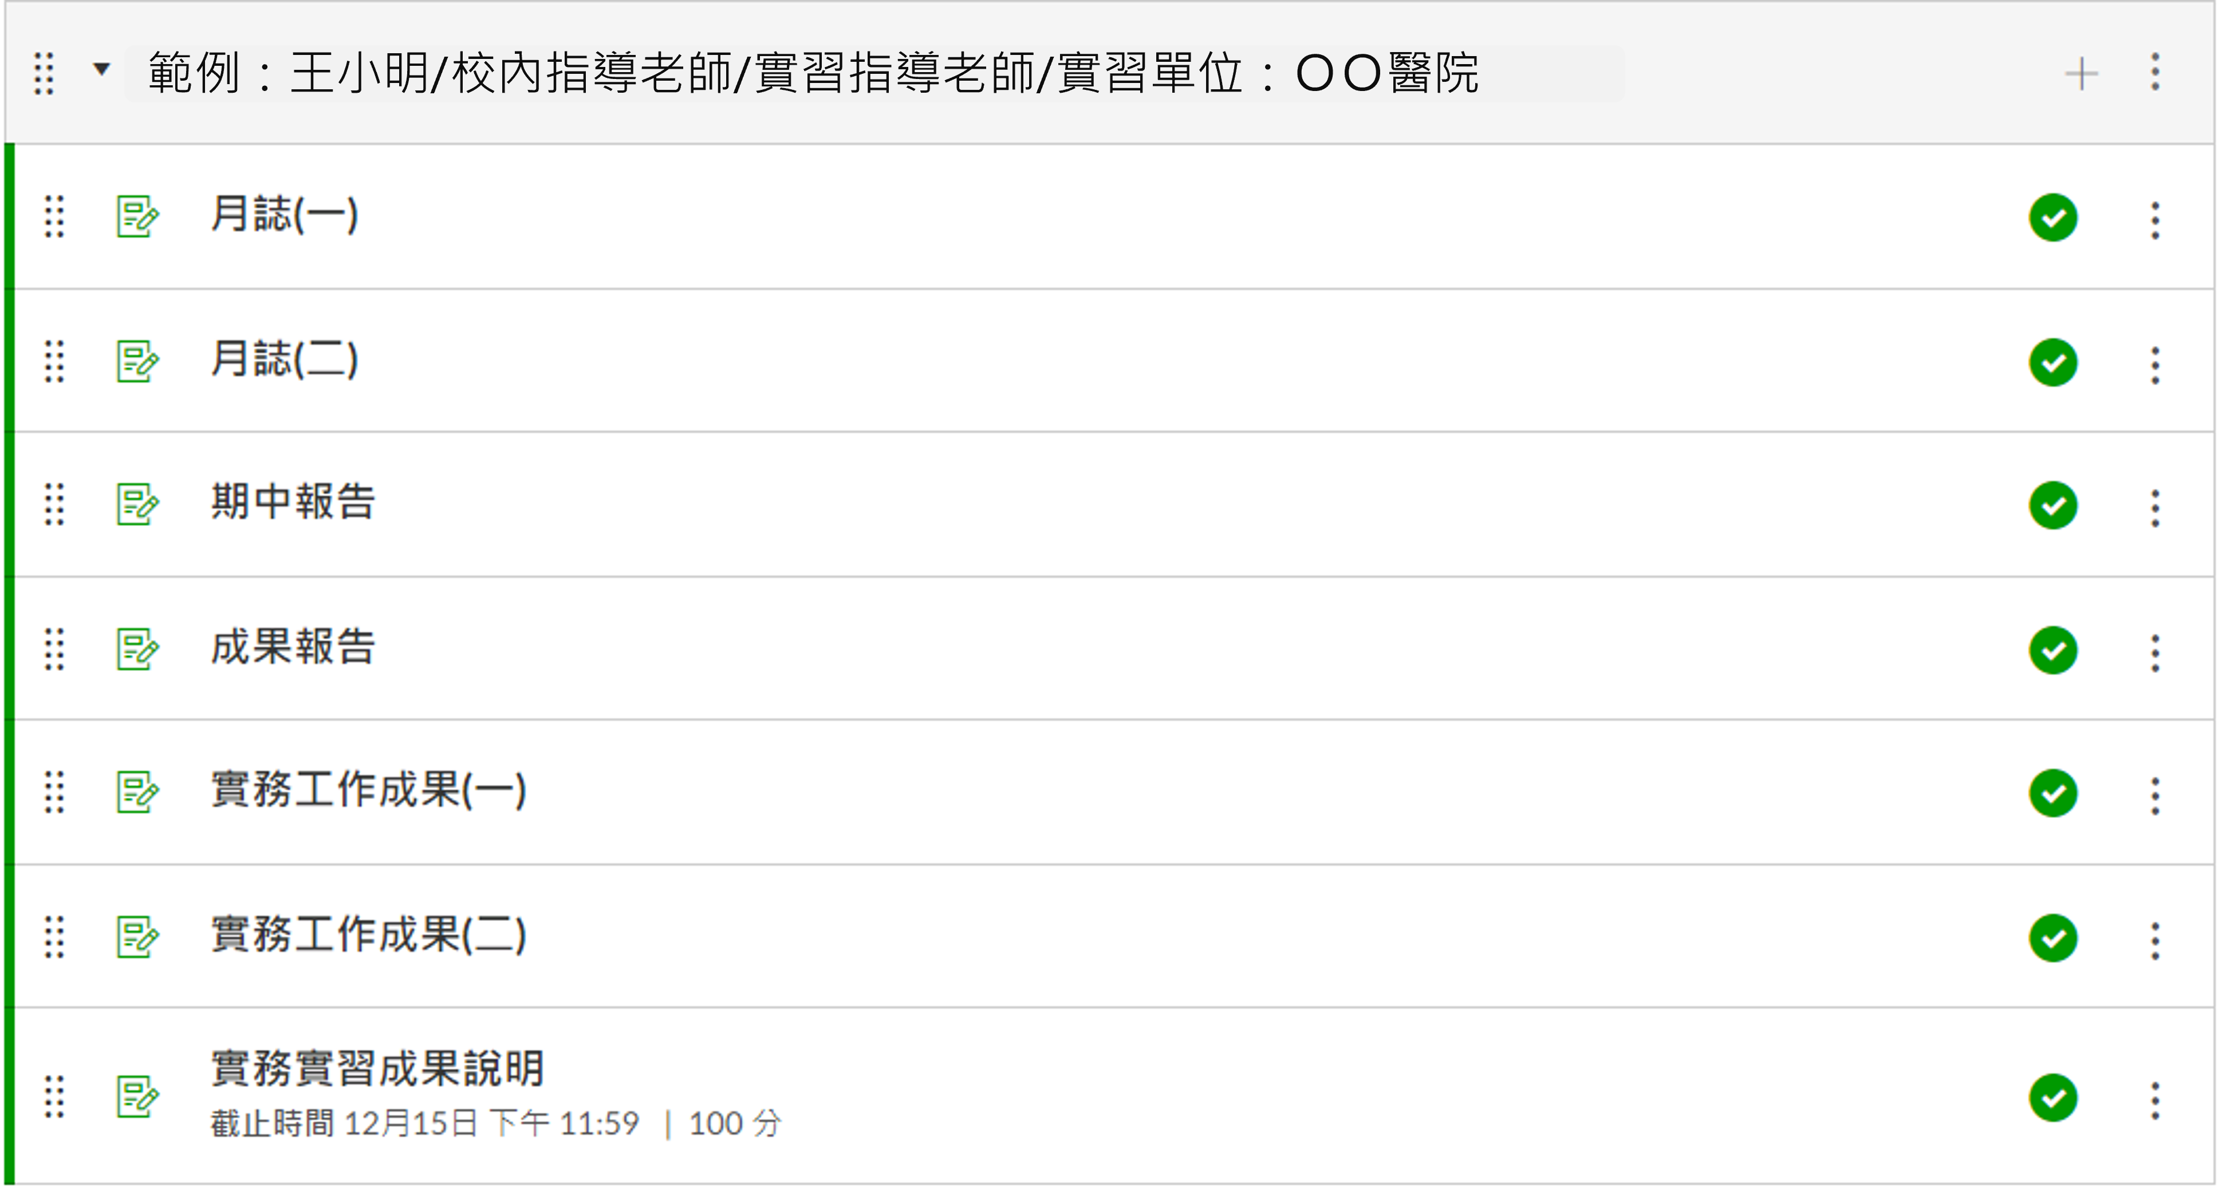
月誌、期中報告、成果報告、實務工作成果
所有作業請都先給指導老師看過後再上傳。

Slide 6
核心能力及實習工作成果
核心能力
  CEPH規定之22項基本核心能力
  MPH各領域自訂之領域能力
繳交至少兩項工作成果: 須達共計5項以上的核心能力
      至少3項基本核心能力
      其他2項可以為基本核心能力或領域能力
舉例：3基本核心能力+2領域能力、4基本核心能力+1領域能力、
3基本核心能力+3領域能力、4基本核心能力+2領域能力…
Notes:
MPH希望領域能力至少能有一項

Slide 7
CEPH - 22 Foundational Competencies
22項基本核心能力
F1. Apply epidemiological methods to the breadth of settings and situations in public health practice
F2. Select quantitative and qualitative data collection methods appropriate for a given public health context
F3. Analyze quantitative and qualitative data using biostatistics, informatics, computer-based programming and software, as appropriate
F4. Interpret results of data analysis for public health research, policy or practice
F5. Compare the organization, structure and function of health care, public health and regulatory systems across national and international settings
F6. Discuss the means by which structural bias, social inequities and racism undermine health and create challenges to achieving health equity at organizational, community and societal levels
F7. Assess population needs, assets and capacities that affect communities’ health
F8. Apply awareness of cultural values and practices to the design or implementation of public health policies or programs
F9. Design a population-based policy, program, project or intervention
F10. Explain basic principles and tools of budget and resource management
F11. Select methods to evaluate public health programs
F12. Discuss multiple dimensions of the policy-making process, including the roles of ethics and evidence
F13. Propose strategies to identify stakeholders and build coalitions and partnerships for influencing public health outcomes
F14. Advocate for political, social or economic policies and programs that will improve health in diverse populations
F15. Evaluate policies for their impact on public health and health equity
F16. Apply principles of leadership, governance and management, which include creating a vision, empowering others, fostering collaboration and guiding decision making
F17. Apply negotiation and mediation skills to address organizational or community challenges
F18. Select communication strategies for different audiences and sectors
F19. Communicate audience-appropriate public health content, both in writing and through oral presentation
F20. Describe the importance of cultural competence in communicating public health content
F21. Perform effectively on interprofessional teams
F22. Apply systems thinking tools to a public health issue
本資訊學程網站及申請書內皆有

Slide 8
Biostatistics
Concentration Competencies
生物統計領域能力
生統BIOSTAT1. Apply advanced statistical methods to longitudinal, clustered, or correlated data in public health and interpret the results with non-technical terms.
生統BIOSTAT 2. Frame clinical and epidemiologic questions into a testable research hypothesis, and design an experiment and select appropriate statistical methodologies to test the hypothesis.
生統BIOSTAT 3. Select appropriate statistical methods for analyzing and modelling data of different measurement scales from various types of study design.
生統BIOSTAT 4. Synthesize the results of advanced quantitative methods to draw valid inferences and summaries.
生統BIOSTAT 5. Advise public health professionals on decision making with non-technical terms translated from specific study design, statistical analysis, synthesis science, and systems science.
本資訊學程網站及申請書內皆有

Slide 9
Epidemiology and Preventive Medicine
Concentration Competencies
流行病學與預防醫學領域能力
流預EPM1. Apply epidemiological methods to identify risk factors of non-communicable chronic diseases, and to estimate the effect size regarding the impact of various levels of specific interventions.
流預EPM2. Apply epidemiological principles in planning infectious diseases prevention and control projects.
流預EPM3. Be equipped with the ability to translate advanced epidemiological knowledge into infectious diseases control decision-making and policy-formulation.
流預EPM4. Apply economic evaluation method to provide evidence on decision-making for health promotion program in different organizations or settings.
流預EPM5. Develop advanced writing and presentation skills pertaining to epidemiological study design, analysis, interpretation of results, and in-depth discussion on both non-communicable diseases and infectious diseases.
本資訊學程網站及申請書內皆有

Slide 10
Health Policy and Management
Concentration Competencies
健康政策與管理領域能力
健管HPM 1. Propose how to solve the issues in order to improve performance of Taiwan's health system.
健管HPM 2. Provide an effective operation for health service organizations and develop strategies to promote an organization’s position.
健管HPM 3. Identify the key components and processes of policy-making and leverage the principles and technique of research methodology to improve policy-making and promote population health.
健管HPM 4. Systematically identify and analyze current policy issues that Taiwan faces; evaluate policies’ effectiveness, efficiency and equity and find a feasible solution for these issues.
健管HPM 5. Apply economic, health managerial knowledge and policy analysis to understand costs issues associated with health care services. Develop financial management plans and budgets for sectors or service organizations in health care.
本資訊學程網站及申請書內皆有

Slide 11
Health Behaviors and Community Sciences
Concentration Competencies
健康行為與社區科學領域能力
行社HBCS 1. Develop, implement, and evaluate public health programs, practices, policies, and interventions based on theories of health behaviors and community sciences.
行社HBCS 2. Synthesize current public health issues related to social, psychological, and behavioral determinants.
行社HBCS 3. Evaluate methodological and ethical issues relevant to behavioral and community sciences.
行社HBCS 4. Analyze the roles of interpersonal interactions and communication in shaping people's behavior on the basis of social/behavioral theories.
行社HBCS 5. Integrate various skills to evaluate community relationships and engage with community residents of different social, economic, and cultural backgrounds.
本資訊學程網站及申請書內皆有

Slide 12
Environmental Health Sciences
Concentration Competencies
環境健康科學領域能力
環職EOHS 1. Examine the methods used to identify and assess sources and health impacts of significant environmental and occupational hazards.
環職EOHS 2. Analyze important food safety issues and distinguish correct information from news and other media sources using science-based food sanitation and safety approaches.
環職EOHS 3. Analyze key components and processes of policy-making and comment critically on current environmental health policy issues.
環職EOHS 4. Analyze important environmental health issues by a systematic and scientific approach.
環職EOHS 5. Recognize the factors influencing susceptibility to health effects resulting from exposures in environmental and occupational settings.
本資訊學程網站及申請書內皆有

Slide 13
實務實習工作成果說明
工作成果是回饋給實務實習單位
一項工作成果可以對應多項核心能力
以「非學術性」的方式呈現
  請以工作成果是要給單位主管的角度來思考與設計
問題：能不能就以寫論文的方式呈現？或單純做個PPT當作工作成果？
不行！不行！不行！
Notes:
工作成果不是給學校的
The product must be like those that would be summitted to a work supervisor at a job

Slide 14
實習工作成果範例
  因應實務實習單位之需求，所設計的問卷或調查工具
  替實務實習單位所進行的數據分析結果報告
  呈現給利害關係人（如：社區成員、實務實習單位的其他成員） 的結果摘要；
  替實務實習單位所規劃之健康促進訓練指引
  提供給客戶的健康資訊文宣
  提供給實務實習單位指導老師的簡報，其內容主要是用來幫助實務實習單位進行後續決策及行動

Slide 15
實習工作成果範例
生物統計
流行病學與
預防醫學
健康行為與
社區科學
環境健康科學
  院刊投稿
  文獻回顧統整
  疾病評估報告
  數據分析指引
  譯碼簿
  分析決策建議
  教育文宣
  調查報告
  網路專刊
  衛教手冊
  政策比較表
  資料收集表
  檢驗成果報告

Slide 16
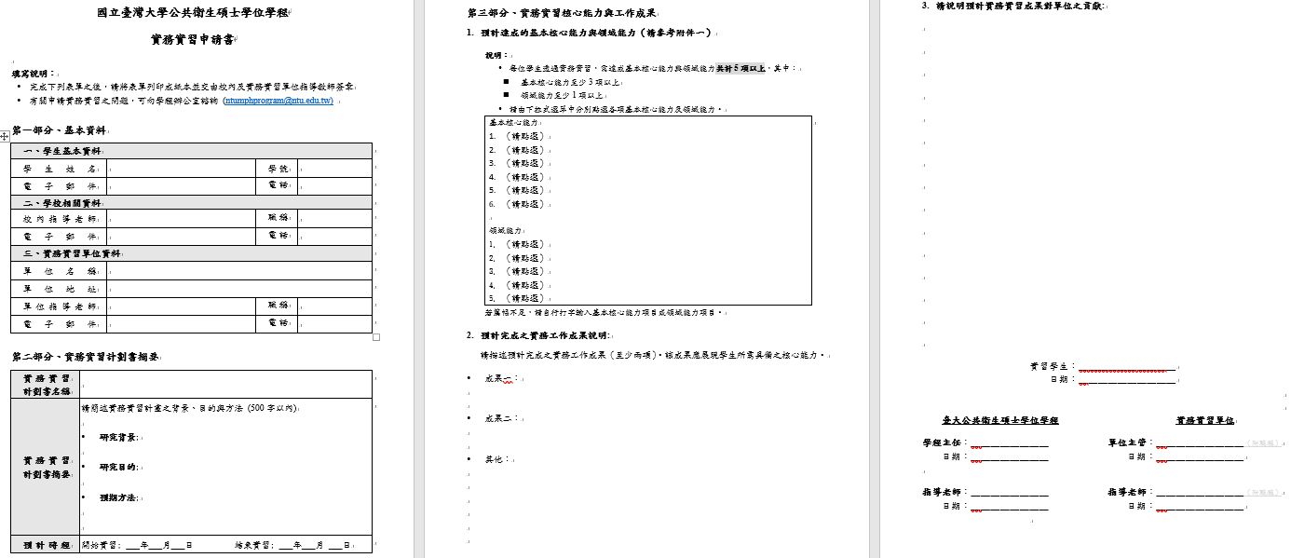
實務實習申請書
由學程辦公室於
收件截止後
統一給主任簽名
下拉式選單
請由校內指導老師、實習單位指導老師及單位主管簽名後交給學程辦公室
請與實習單位主管及校內指導老師共同討論後決定

Slide 17
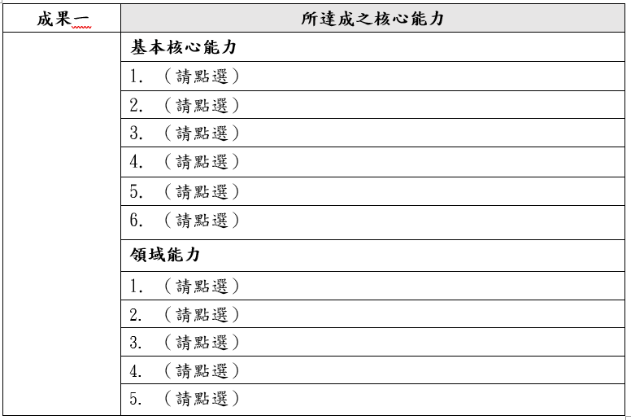
實習工作成果說明
實習進行後，需繳交實習工作成果說明。
簡單說明完成之實習工作成果，並點選所對應達成之核心能力。
呈現成果名稱即可，如：問卷、分析報告、文宣、文獻整理表。
Notes:
可以輔以簡單說明，但不需贅述

Slide 18
實務實習場域安全宣導
實習場域的疏散路線、整體環境、
職業安全衛生法、性別平等工作法等等自身權益。
校內性別平等教育委員會宣導，可參考2/14學程寄給大家的簡報
實習期間遇到任何問題，請主動與校內指導老師
及學程辦公室聯絡，我們會盡全力協助您。

Slide 19

本學期活動預告…

Slide 20
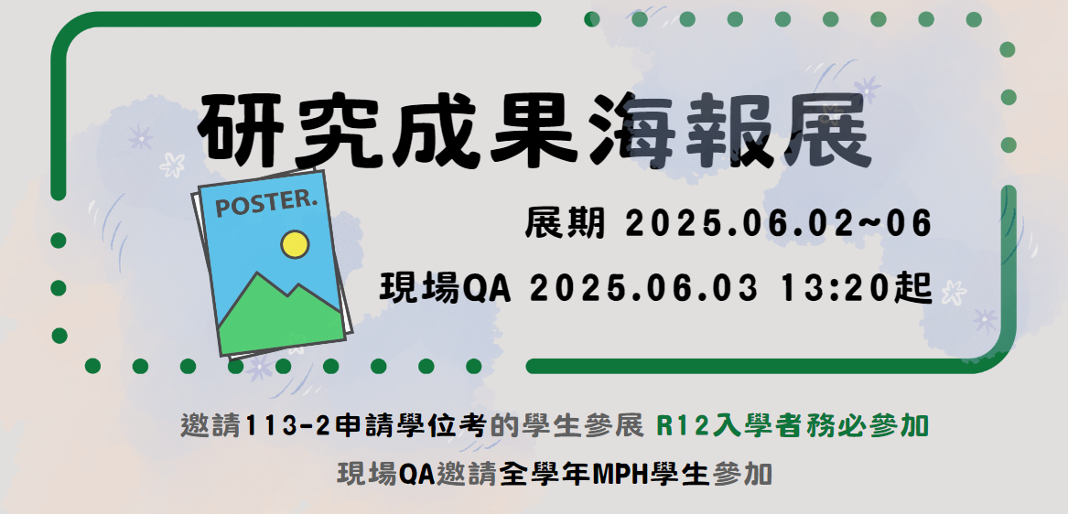
修業規定：學程於每學期期末舉辦「公共衛生碩士學位學程海報展」，
同學於在學期間須參加至少一次，內容可為實務實習成果、或是研究成果。

Slide 21


校友演講
李思慧 輝瑞大藥廠 策略醫療經理 – 5月 (週二中午12:20，全球廳)
江芝林 嬌生公司楊森藥廠 處長 – 6/3 (適逢海報周，週二中午12:20，全球廳)
李宜娟 環管署綜合規劃組 技正 – 9/9 (開學第二周的週二中午12:20，全球廳)
新生座談會 – 8/22(周五下午3:30，拱北講堂)
歡迎有興趣分享的大家來跟一年級新生交流認識

Slide 22


~歡迎提問~
學程辦公室：公衛大樓一樓R122(院辦公室)
學程助理：趙芷瑩、邱韶薇
Line ID：@657kjaer

